Slide 1
Success Bound Conference
Ohio Department of Higher Education Workforce Initiatives

Slide 2
Higher Education Workforce Initiatives
OhioMeansJobs – Supply Tool
Regionally Aligned Priorities in Delivering Skills (RAPIDS)
Workforce Development Revolving Loan Program
Ohio Means Internships and Co-ops (OMIC)
Apprenticeships
Industry- and Sector-based Strategies
Career Development/Student Success

Slide 3

OhioMeansJobs – Workforce Resources
In-Demand Jobs Week
  http://omj.ohio.gov/indemandjobsweek/index.stm
OMJ
  https://jobseeker.ohiomeansjobs.monster.com/
Key Links
  Workforce Professionals https://jobseeker.ohiomeansjobs.monster.com/ExploreIt/WfProfessionals.aspx
  The In-Demand Information
  http://omj.ohio.gov/OMJResources/WorkforcePros.stm

Slide 4
OhioMeansJobs – Supply Tool
Historical and projected information on graduates in high demand fields
Identify the number of skilled workers available
Identify relative occupational earnings
Contact information for institutions
Supply Tool- https://workforcesupply.chrr.ohio-state.edu/

Slide 5
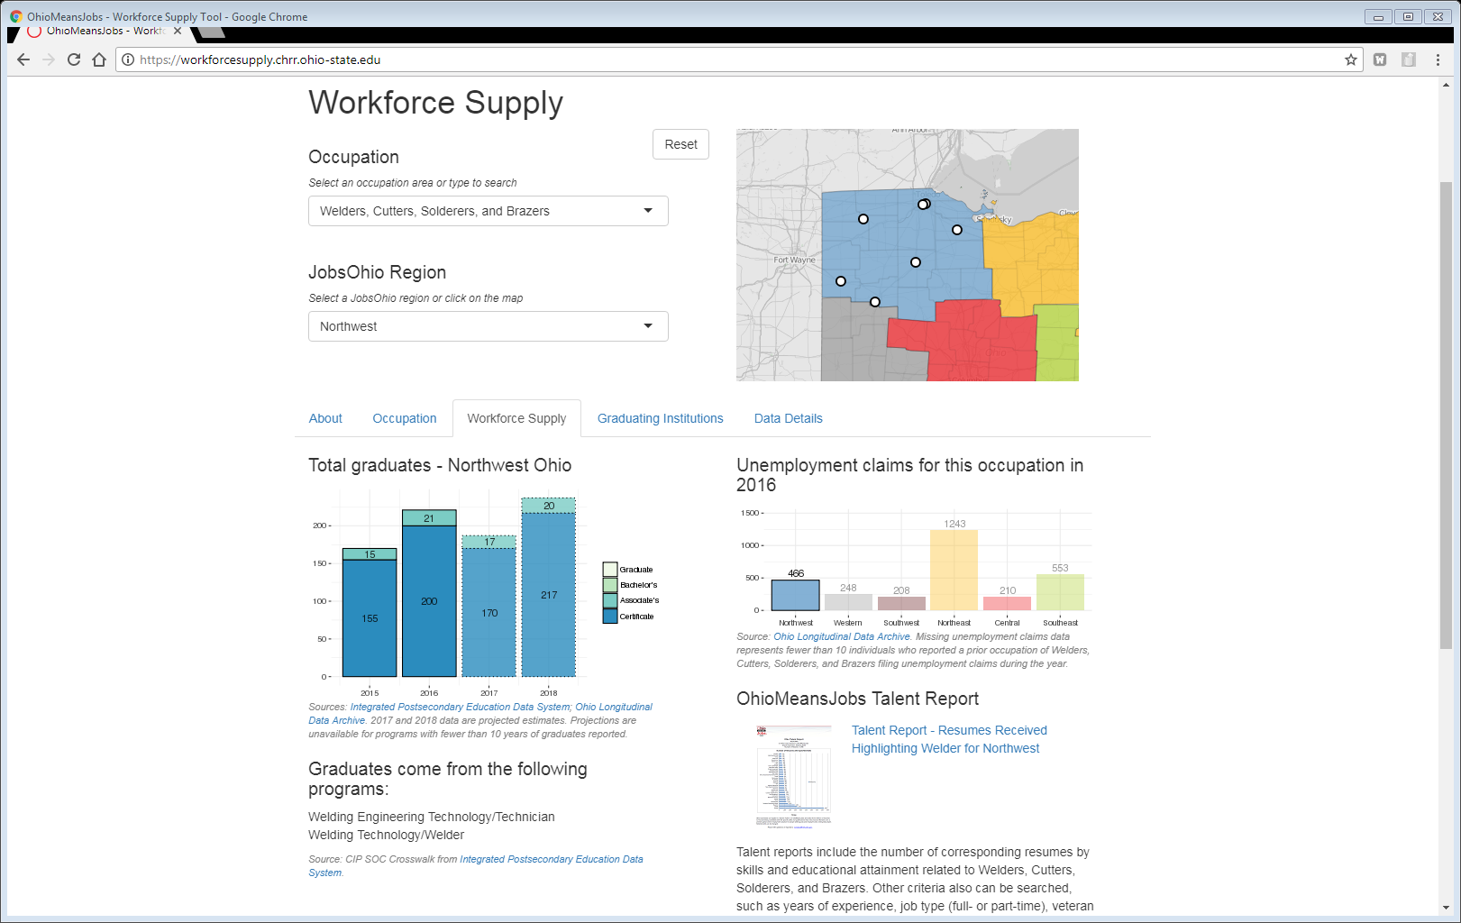
Notes:
Workforce Supply tab shows regional total of recent graduates or certificate completers, as well as projections into the near future. Programs include those in the categories of welding engineering technology and welding technology.
In addition, regional unemployment claims for the occupation are provided; 466 individuals filed unemployment claims in Northwest Ohio in 2016.
Where available, a link to an OMJ report of the number of resumes submitted for this occupation is included.

Slide 6
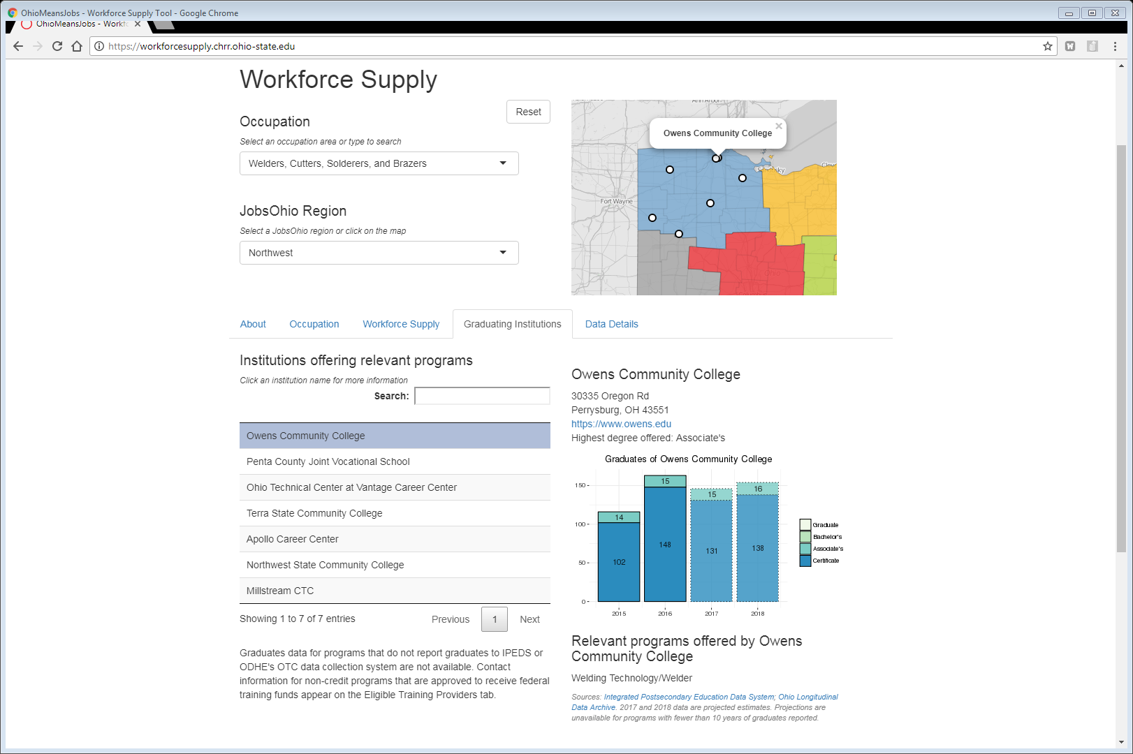
Notes:
The Graduating Institution tab includes a list of postsecondary institutions offering related programs.
Here we selected Owens Community College.
OCC is highlighted on the map above,
A graph of yearly graduates and certificate completers appears to the right, along with near-term graduation projections, and
Address and web address information is provided for more information.

Slide 7

2018 RAPIDS 3
Regional focus
Institutional collaboration
Allocation per region
Strong business support
Equipment for education and training for in-demand occupations

Slide 8
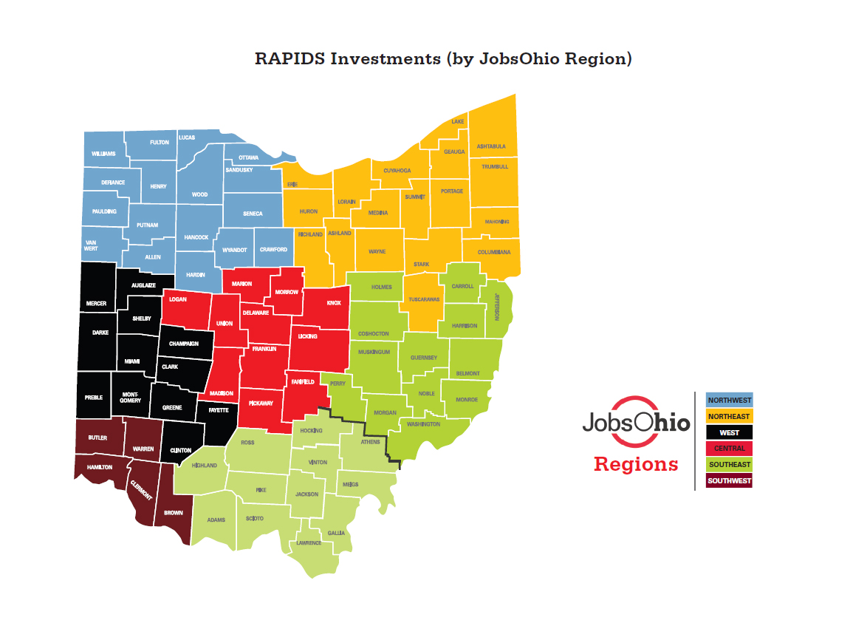

Slide 9
RAPIDS 1 and 2
Institutions are receiving funds and purchasing equipment
Annual report required
  Initial results and equipment
New collaborations developed
  Southwest Ohio – Additive Manufacturing
  North Central State College - Cleveland State University
  Youngstown State University – Ohio Technical Centers
  Shawnee State-Southern State-Rio Grande-OU Southern-Scioto County Career Center-Pickaway Ross Career Center

Slide 10
2017 Regional Investments
Region | Targeted Industries
Northeast Ohio-East | Advanced Manufacturing
Northeast Ohio – Central | Advanced Manufacturing
Northeast Ohio – West | Advanced Manufacturing
Northwest Ohio | Advanced Manufacturing/Cyber Security
West Ohio | Healthcare/Cyber Security
Southwest Ohio | Cybersecurity/Robotics
Central Ohio | Healthcare/Information Technology Advanced Manufacturing
Southeast Ohio-South | Computer Science/Healthcare/Advanced Manufacturing
Southeast Ohio – North | Healthcare/Oil and Gas

Slide 11
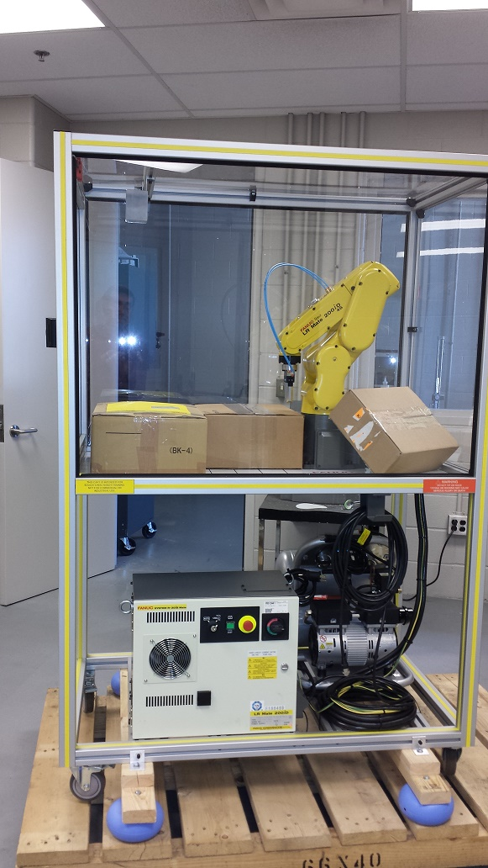
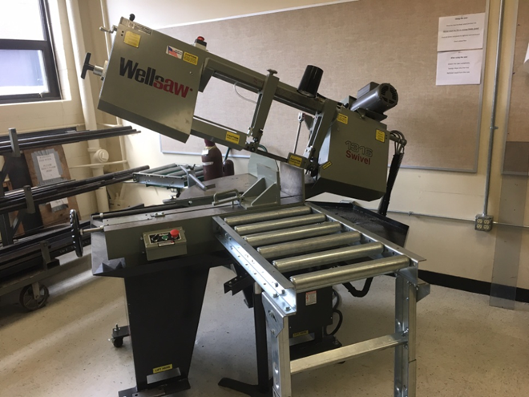
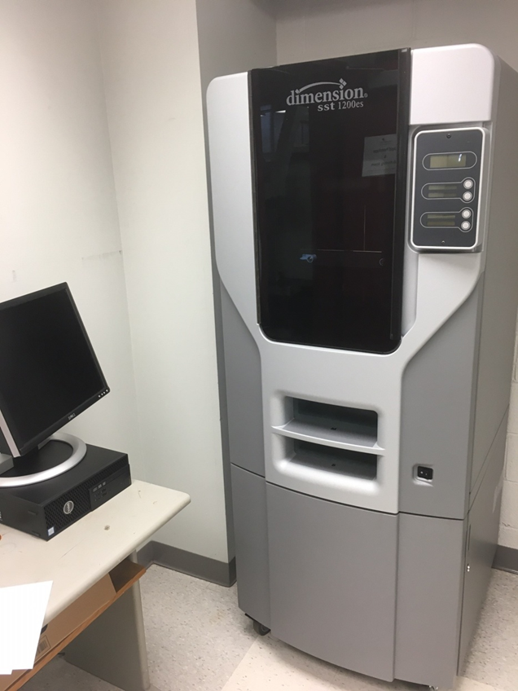
Equipment Purchases – Southwest Ohio

Slide 12
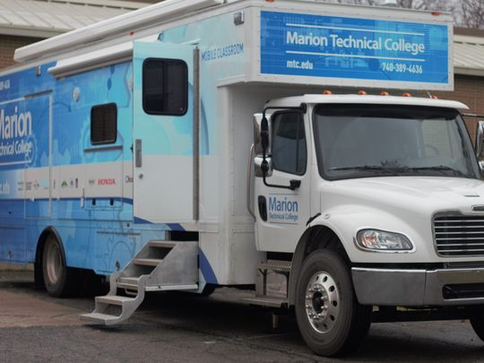
Equipment Purchase

Slide 13
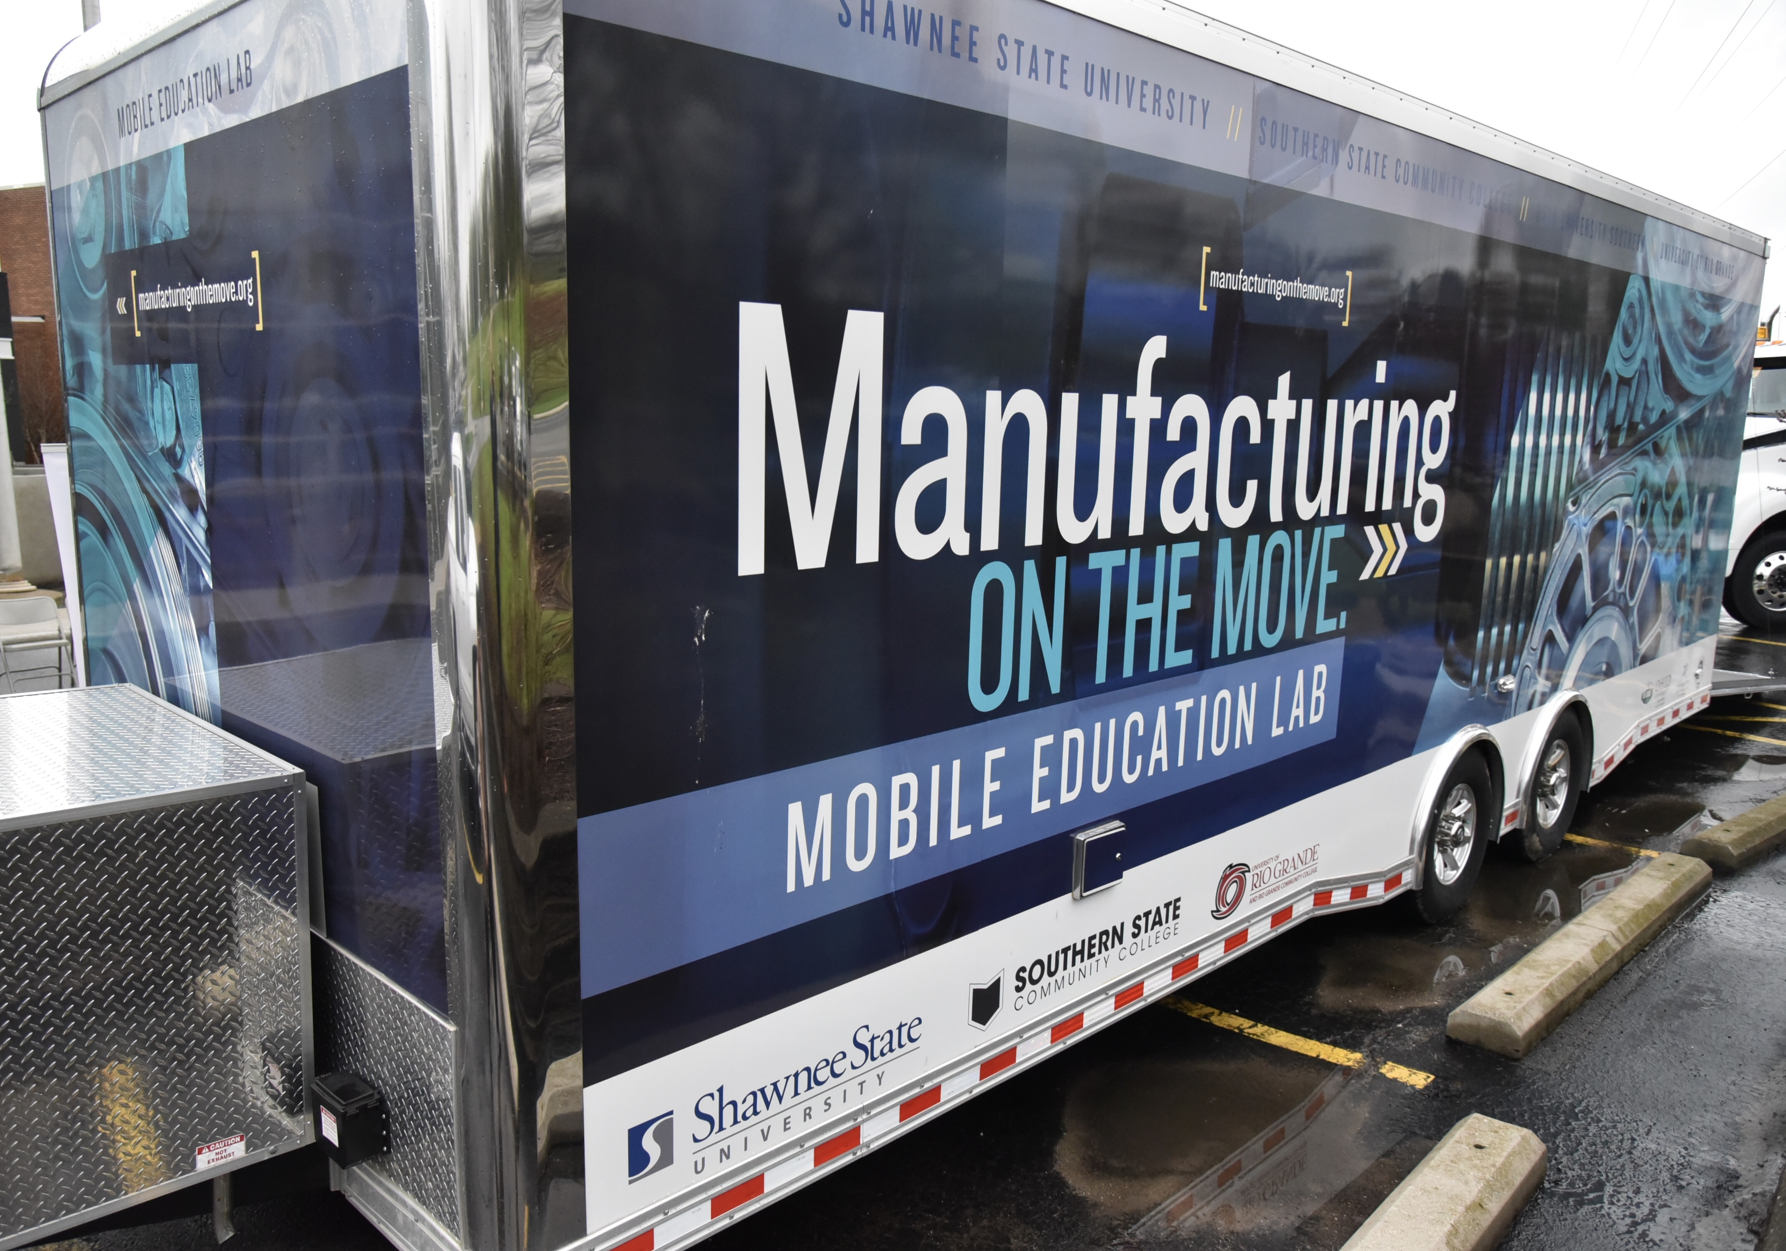
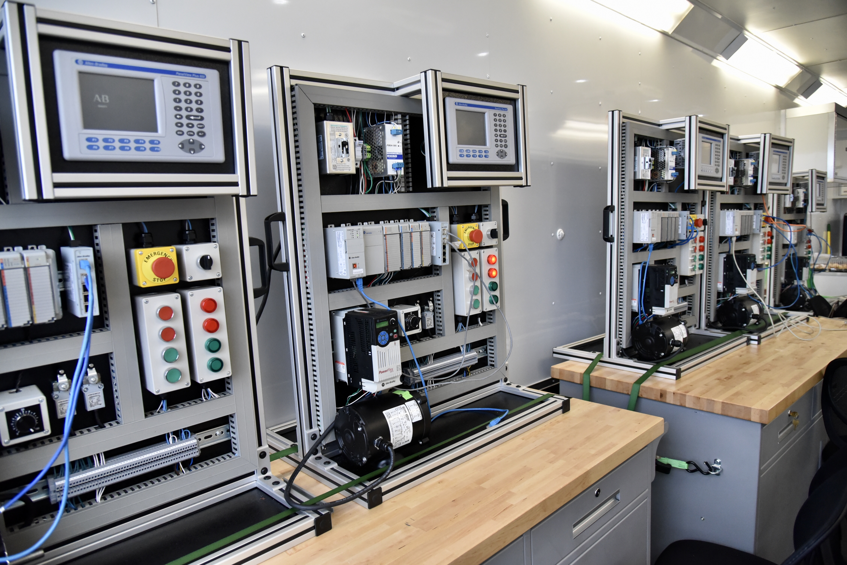
Equipment Purchase

Slide 14
Workforce RLF
Elements
  $250,000 per program
  $10,000 - maximum loan per student
  $5,000 average student loan
Three open programs
$500,000 maximum funding at one time

Slide 15
Workforce Development RLF process
ODHE
Application submitted
ODHE & TOS
Award letter
TOS
Loan approvals
Loan servicing
Revised
Recommended
Grant agreement
Loan disbursements

Slide 16
Workforce Loan Application
Keys
  Documented business support
    Need to hire and willingness to interview
  Tuition reimbursement encouraged
    CDL – student stays with a company receives assistance
  Loan Counseling
  Recruiting

Slide 17
Loan Structuring Strategy
Down payments by students
Varied loan amounts depending on need
Revolving loan in combination with other funds

Slide 18
Ohio Means Internships and Co-ops (OMIC)
OMIC 4
  Regional focus
  Universities (public and private), Community Colleges, and Ohio Technical Centers
  Targeted industries
  In-demand occupations

Slide 19
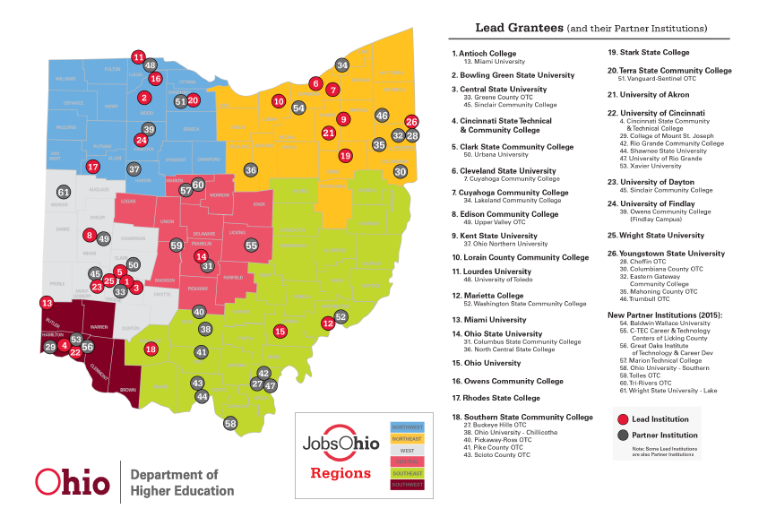

Slide 20
OMIC – Regional Strategies
Institutional Focus
  Support from the participating institutions
  Opportunity to strengthen programs and best practices
  Student Focus
    Targeted populations: first generation, veterans, etc.
    Faculty engagement to support increased internships and co-ops
  Business Focus
    Collaborative marketing
    Targeted industries
    Selected in-demand occupations
Notes:
Regional marketing
Engagement with College Credit Plus students
Local partnerships with small-medium sized companies
Support for student travel and housing
Internship preparation courses developed with business
Business subsidies on sliding scale

Slide 21
OMIC – Funded Activities
Regional marketing
Engagement with College Credit Plus students
Local partnerships with small-medium sized companies
Support for student travel and housing
Internship preparation courses developed with business
Business subsidies on sliding scale

Slide 22
2017 Summary Accomplishments
Placements
  3,976 co-op students
  1,772 intern students
Businesses
  945
Private match
  $24.5 million
Post-completion employment
  2,241 students employed in Ohio
  Average wage $39,000

Slide 23
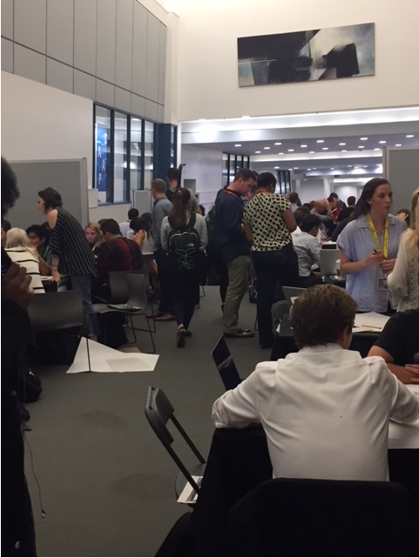
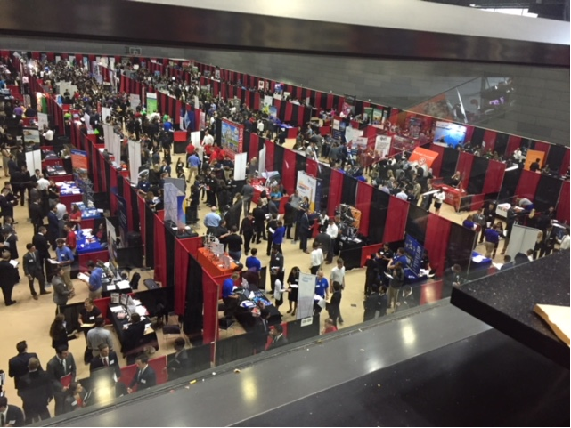
Student Engagement and Career Fairs

Slide 24
Top Industries
Industry | Percent Participation
Manufacturing | 42%
Professional and Technical Services | 14%
Other Services | 8%
Finance and Insurance | 6%
Retail Trade | 5%
Information | 5%
Construction | 3%

Slide 25

Apprenticeships
Cooperation with the Apprenticeship Ohio
  Registered Apprenticeships
Pilot program with Community Colleges
Exploring opportunities to expand with Ohio Technical Centers

Slide 26
Manufacturing
Increase the pipeline of talent
  Improve and deepen skills
  Identify new skills
New collaborations
  Technet
  LIFT grant
  Ohio Manufacturers Association
Support for apprenticeships
Review of the place of industry certificates
Foundational courses
Image and marketing

Slide 27

Advanced Technology- IT
Cyber Security – OC3
  Education sub committee
Business partners
  Producers of technology
  Consumers of technology
Develop a diverse pipeline
Building pathways - K-16

Slide 28


Construction
Strong and growing business demand
Coordination with technical centers and community colleges
Promote certificates and credentials
Image and marketing

Slide 29
Career Development/Student Success
Academic and career advising connected
Career services
  Partnerships with industry
  Faculty engagement
Student engagement
  Connection to the institution
  Entry pathways and services
  Progression – focusing on the finish
  Completion and opportunities for the future

Slide 30
THANK YOU
Cheri Rice
Associate Vice Chancellor Higher Education Workforce Alignment
614-728-3092
crice@highered.ohio.gov
John Magill
Assistant Deputy Chancellor, Economic Advancement
614-752-9530
jmagill@highered.ohio.gov

